Slide 1
Digital Image Fundamentals (I'm Fun)
2017.09.16
Thuong Nguyen Canh
성균관대학교 정보통신대학
Digital Media Lab.

Slide 2
Content
Camera Image Processing Pipeline
Image and Video Compression
Spatial Image Processing

Slide 3
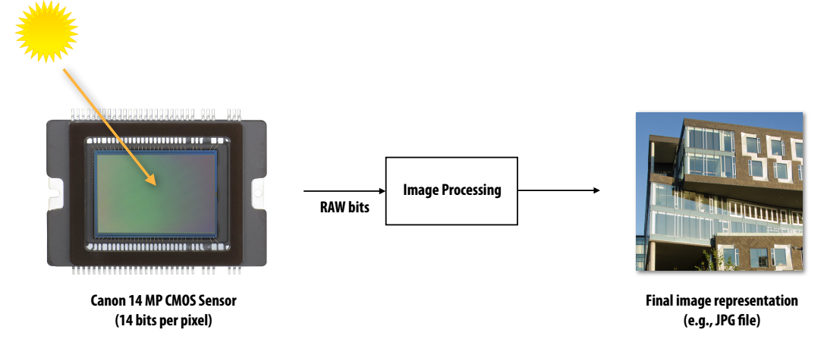
I. Camera Image Processing Pipeline
Sequence operations convert photons hitting sensors to a digital image
K. Fatahalian, Visual Computing Systems, CMU 15-869, Fall 2014

Slide 4
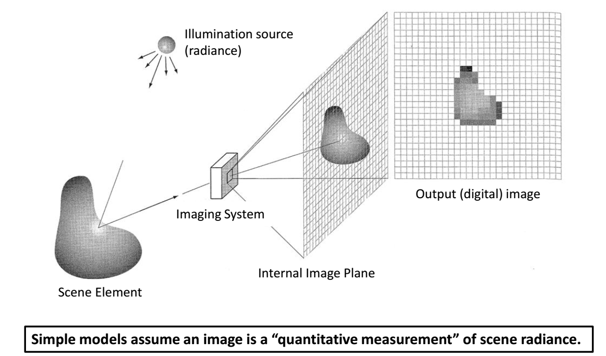
Camera – light measuring device
Image as a radiant-energy measurement
G. Woods, Digital Image Processing,

Slide 5
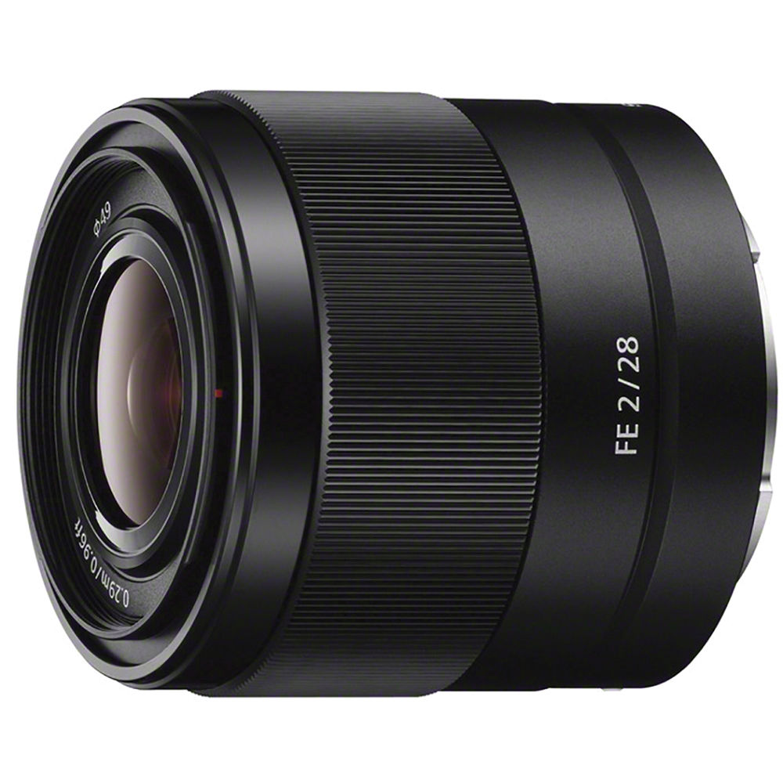
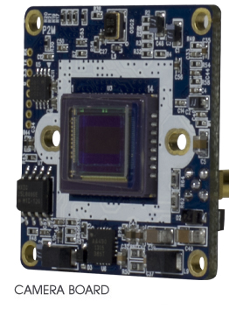




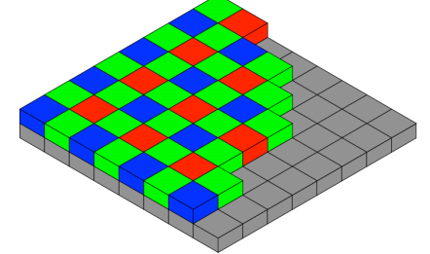
Modern Photography Pipeline
Scene Radiance
In Camera
Post Processing
Pre-Camera
Lens filter
Lens
Shutter
Aperture
Re-touch
Re-lighting
Enhancement etc.
Sensor with color filters
Analog to
Digital
Conversion
White
Balance
CFA
Demosaicing
Noise
Reduction/
Sharpening
Storage
Or
Transmit
Image
Compression
(JPEG, PNG, )
Tone
Reproduction
Color Space
Transform +
Color Preferences
*Some steps can be optional.
M. Brown, Understanding the In-Camera Image Processing Pipeline Tutorial, ppt, CVPR 2016

Slide 6
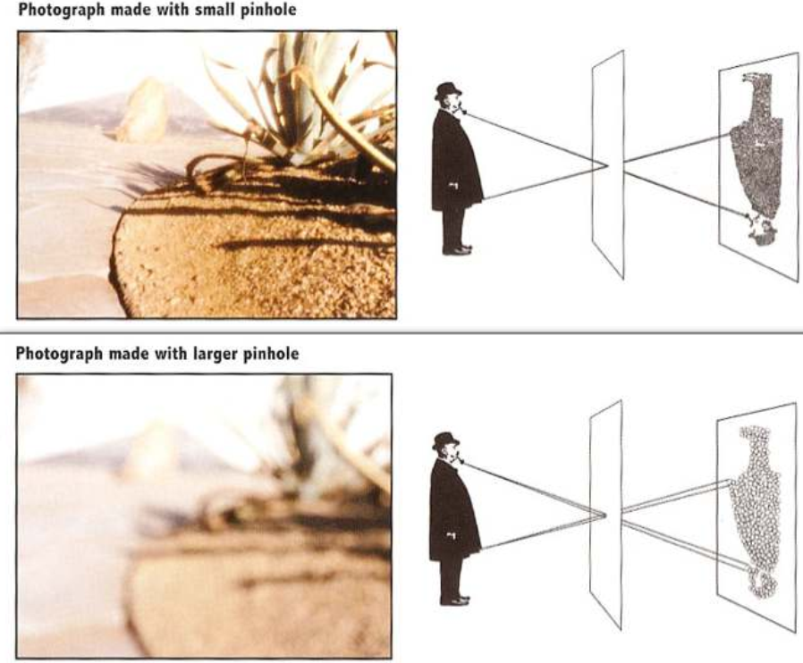
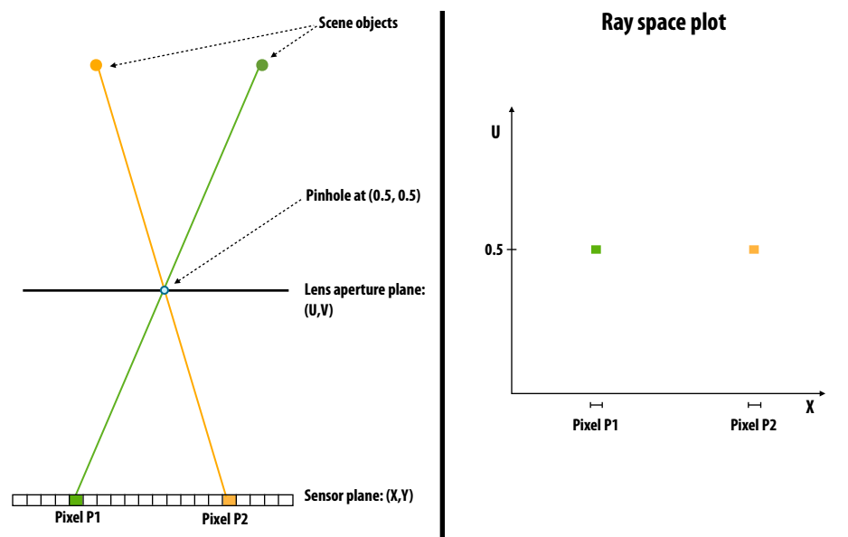
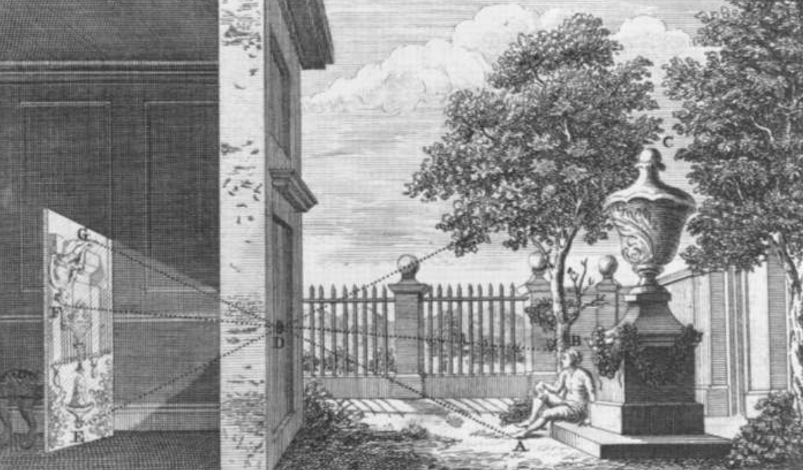
Pre-Camera: Pinhole Camera

Slide 7
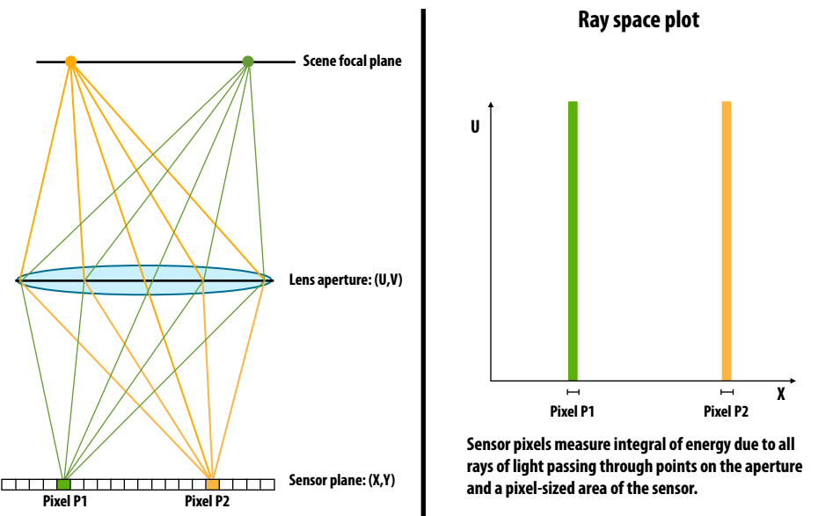
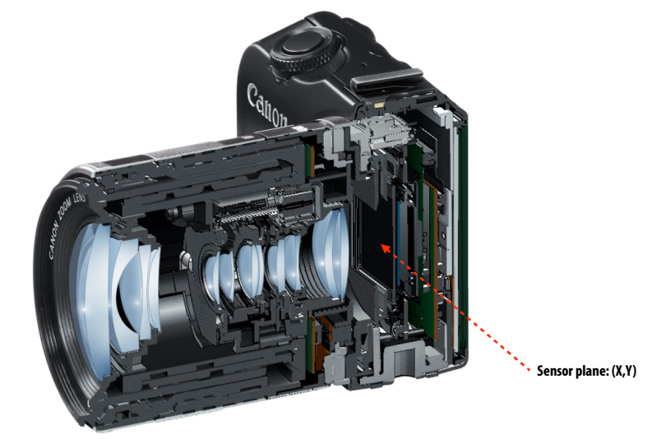
Pre-Camera: Modern Camera

Slide 8
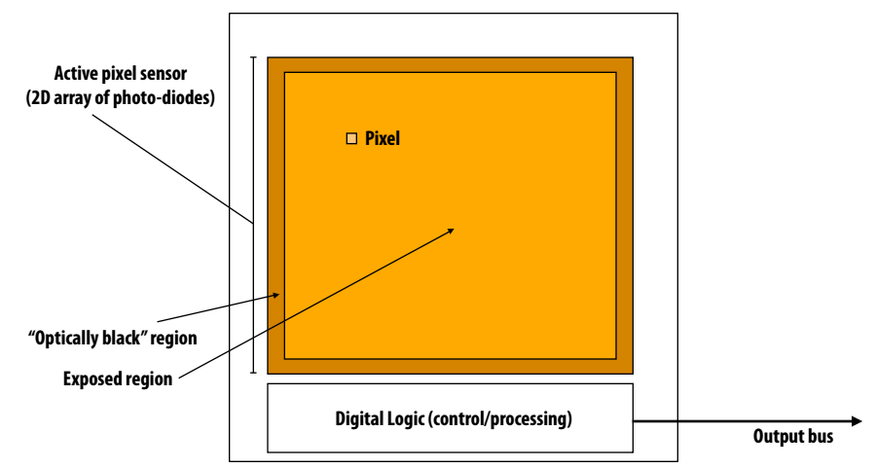
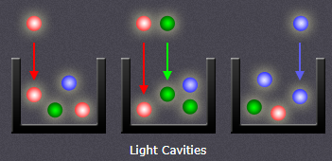
In Camera: Sensor (1)
CMOS Sensor: minions of tiny light cavities

Slide 9
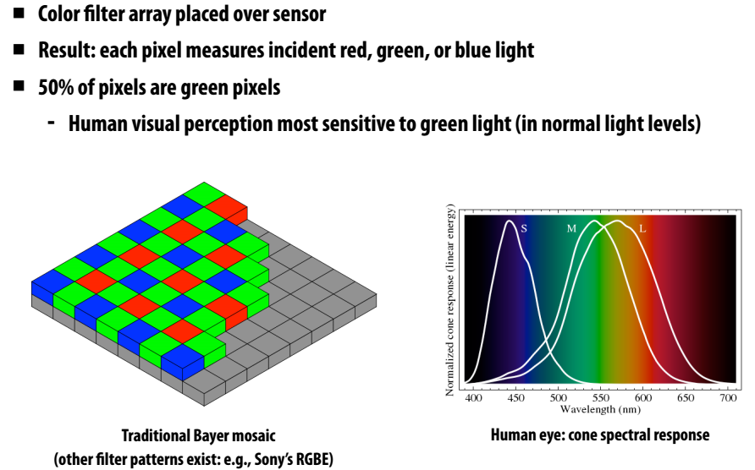
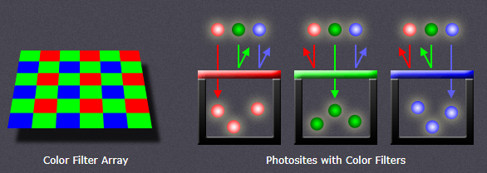
In Camera: Sensor (2)

Slide 10
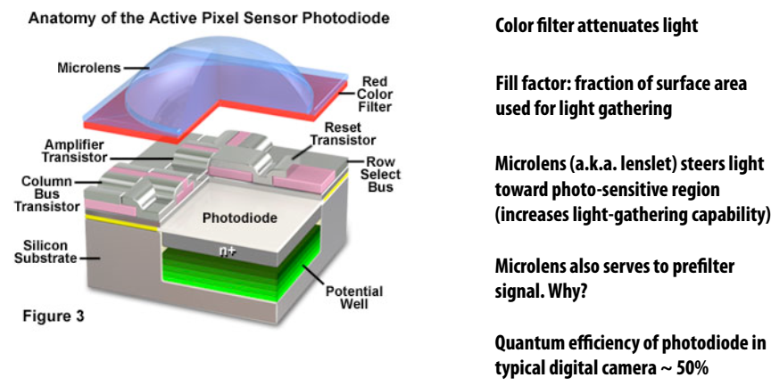
In Camera: Sensor (3)
CMOS Sensor Pixel

Slide 11
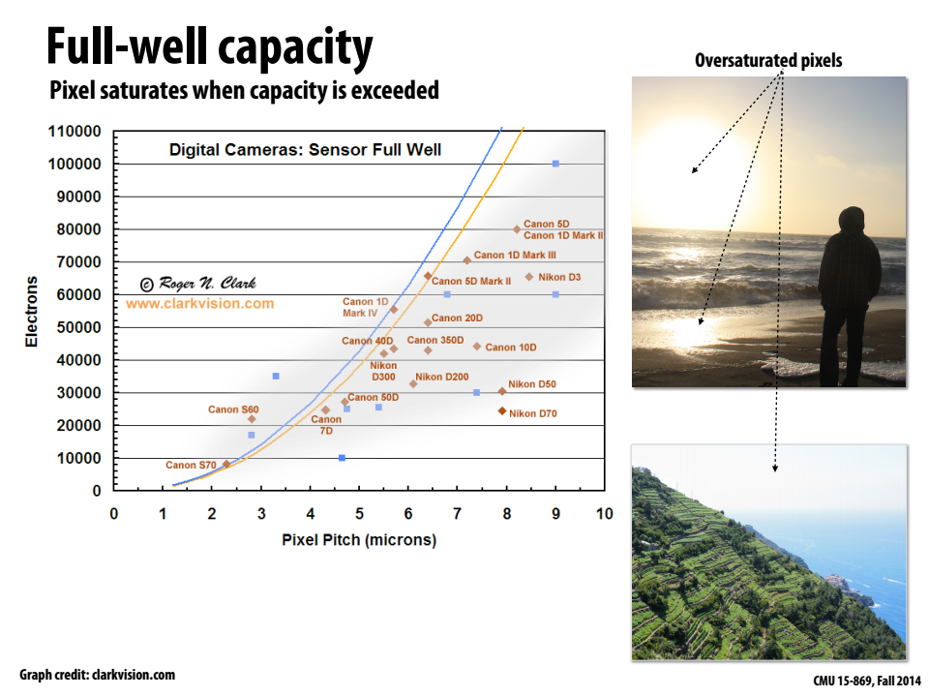
In Camera: Sensor (4)

Slide 12
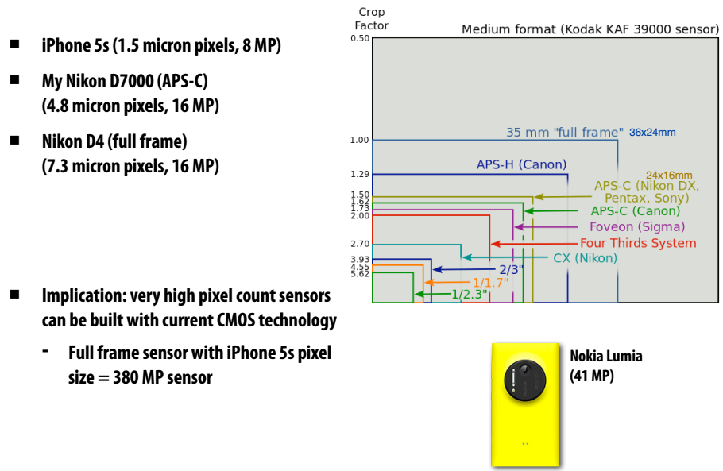
In Camera: Sensor (5)
Bigger sensors = bigger pixels (or more pixels)

Slide 13
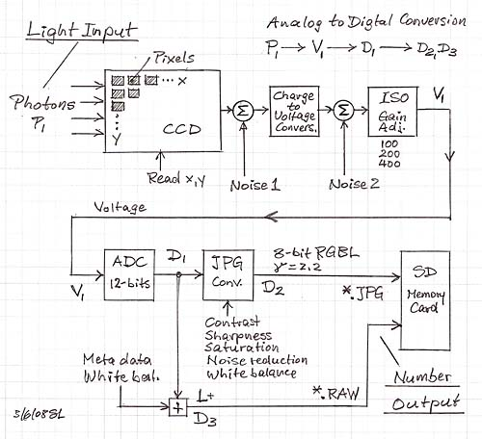
In Camera: Analog to Digital Conversion
Analog to Digital Conversion cncludes
Photon energy → electrical charge → Voltage → Amplify → ADC

Slide 14
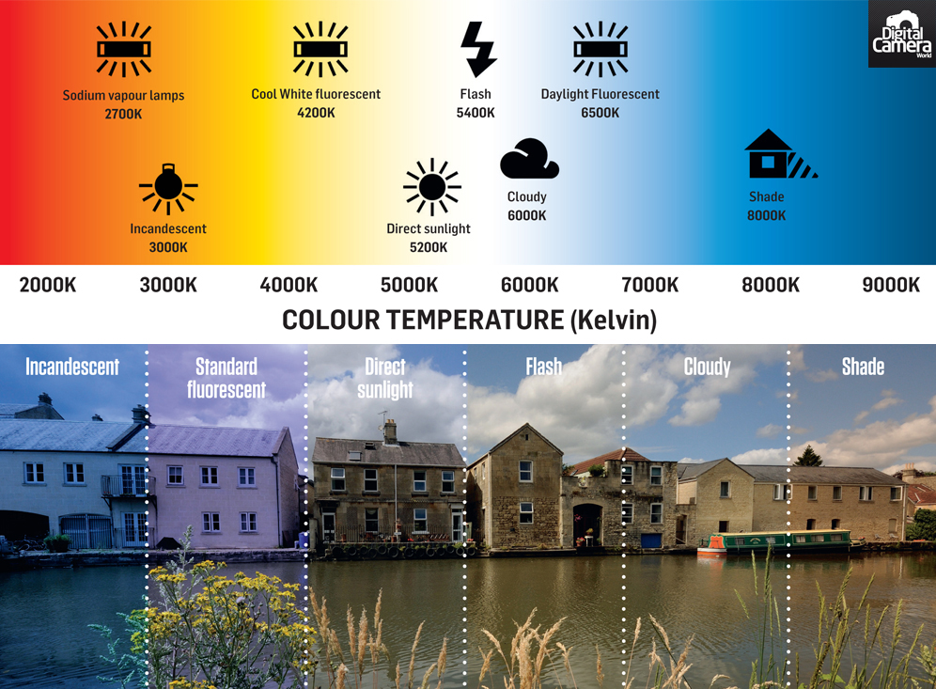
In Camera: White Balancing
The color of the light will affect to colors in your photograph
White balance to correct these color shifts.
Picture taking at different light source show different color

Slide 15
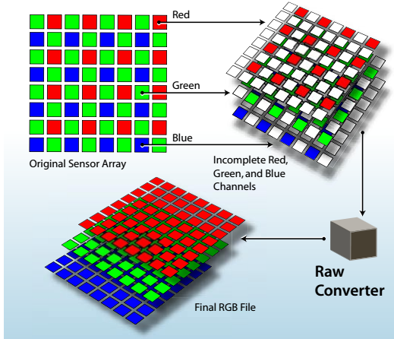


In Camera: Demosaic (1)
Reproduce RGB image from mosaiced input
Original Scene
(shown at 200%)
What Your Camera Sees
(through a Bayer array)

Slide 16
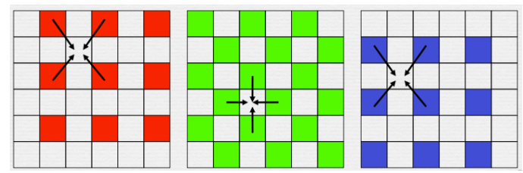
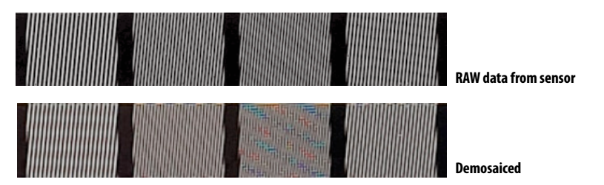
In Camera: Demosaic (2)
Basic algorithm: interpolation
Demosaicing errors
Moire pattern an color artifact

Slide 17
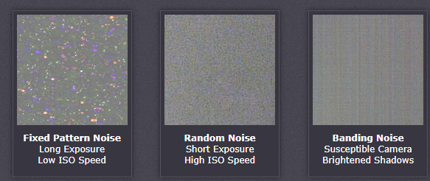
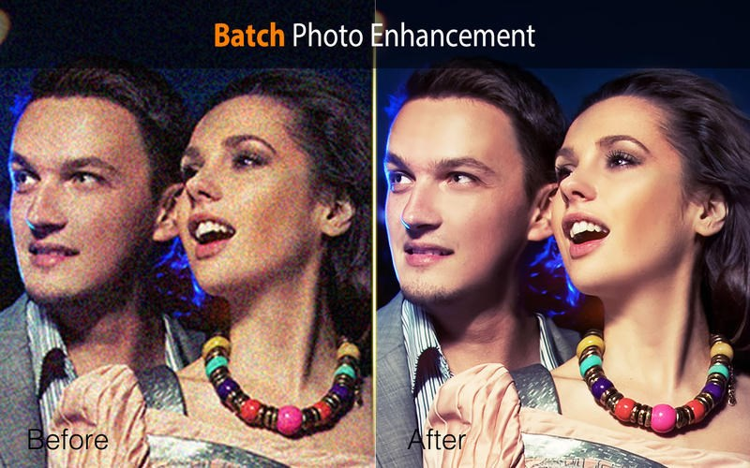
In Camera: Noise Reduction
Noise in digital image: especially at low light condition

Slide 18
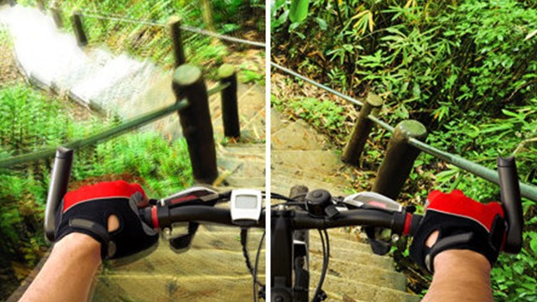
In Camera: Sharpening/Stablization
Motion Blur in digital image

Slide 19
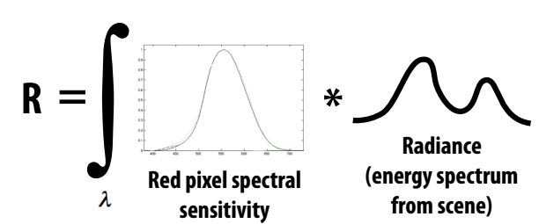
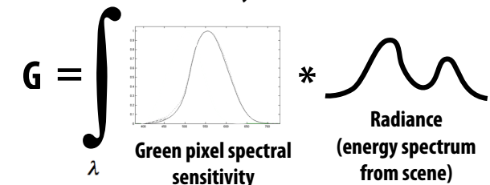
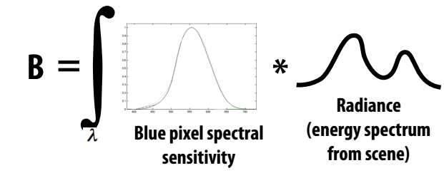
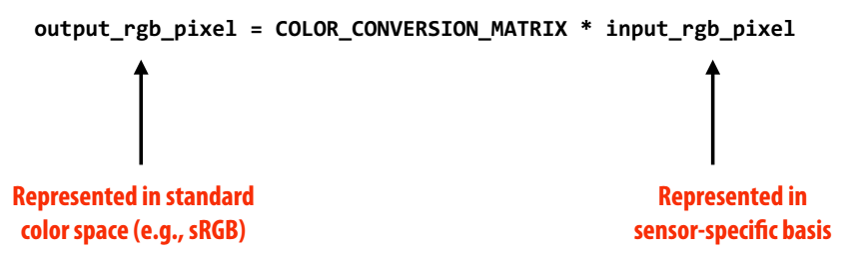
In Camera: Color Space Conversion (1)
Spectral response of sensors are different
Measurements of sensor depend on sensor's spectral response
Response depends on bandwidths filtered by color filter array
Convert to standard color space

Slide 20
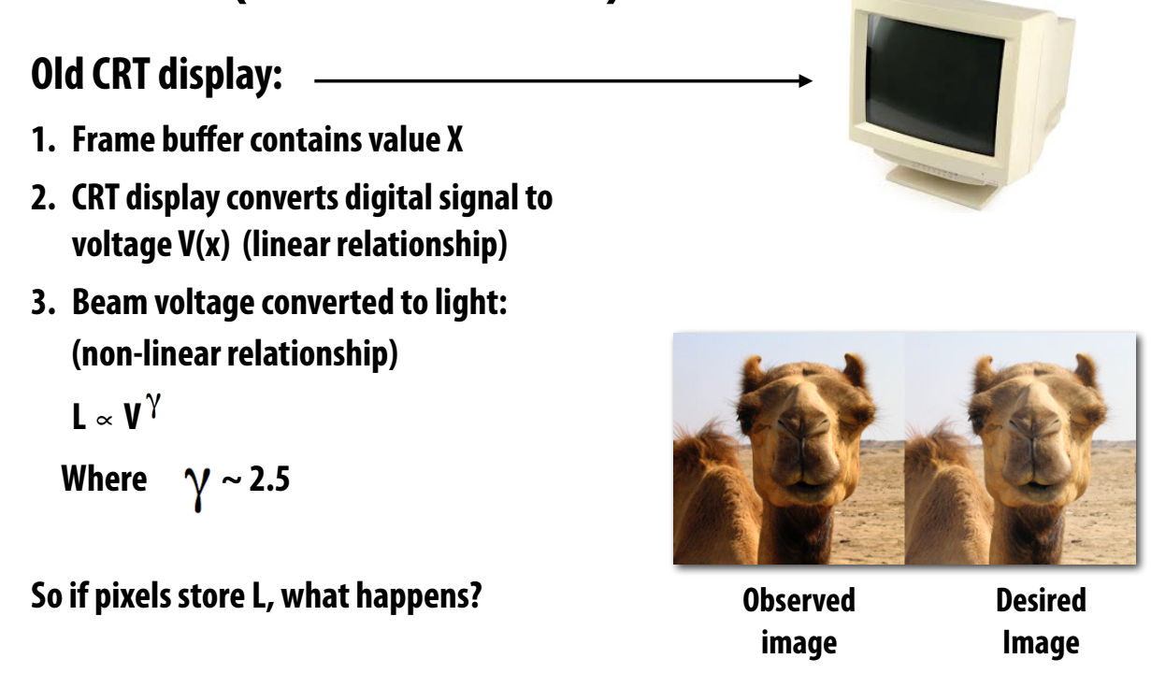
In Camera: Color Space Conversion (2)
Grammar Correction

Slide 21
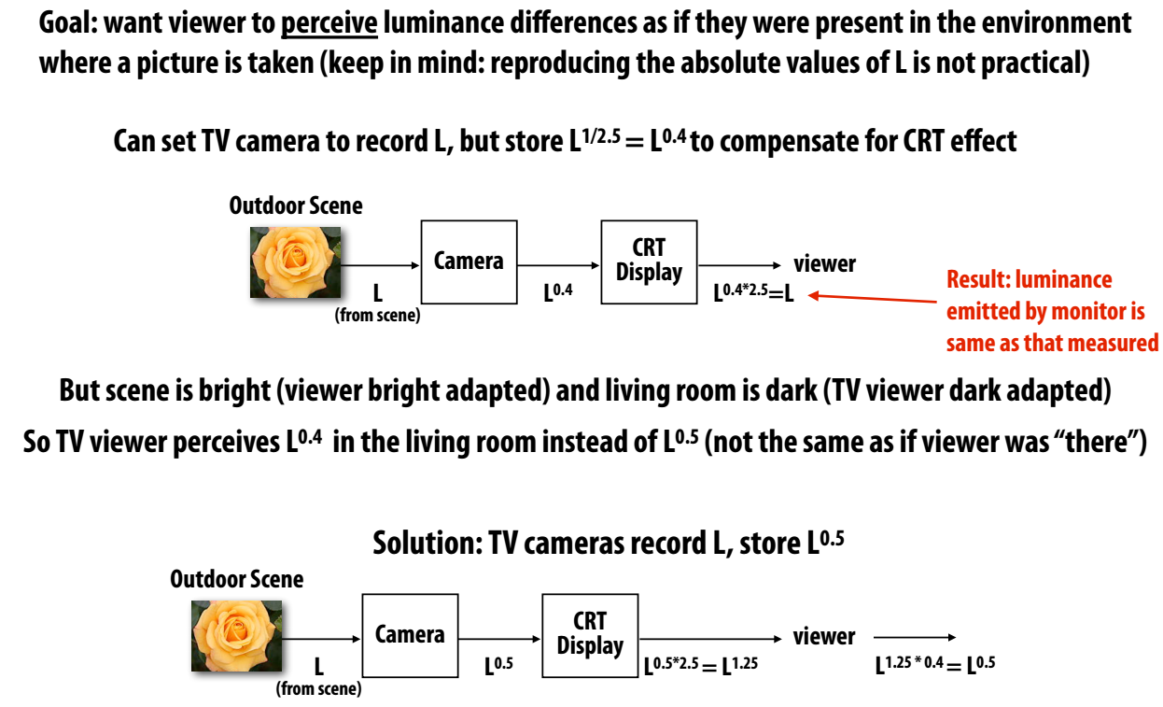
In Camera: Color Space Conversion (3)
Grammar Correction

Slide 22
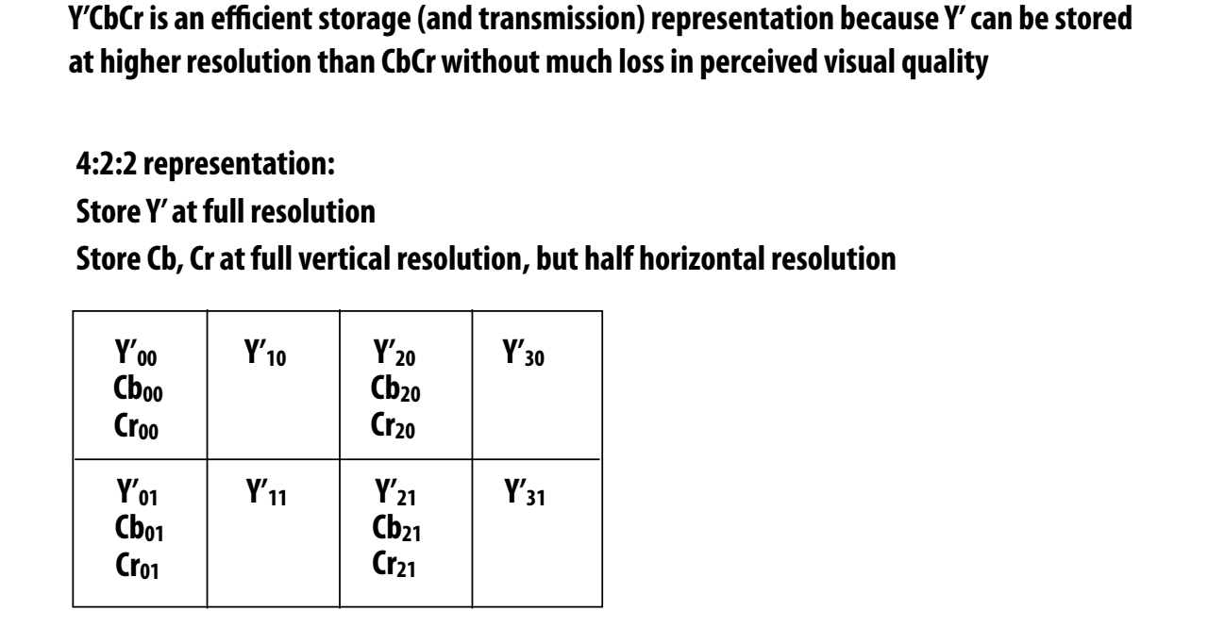
In Camera: Chroma Sub-sampling

Slide 23

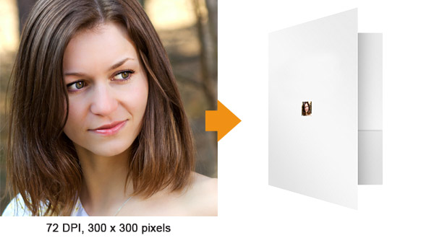
In Camera: Image Compression
To reduce the image for storage or transmission (JPEG)

Slide 24
II. Image Compression - JPEG
Joint Photographic Experts Group

Slide 25
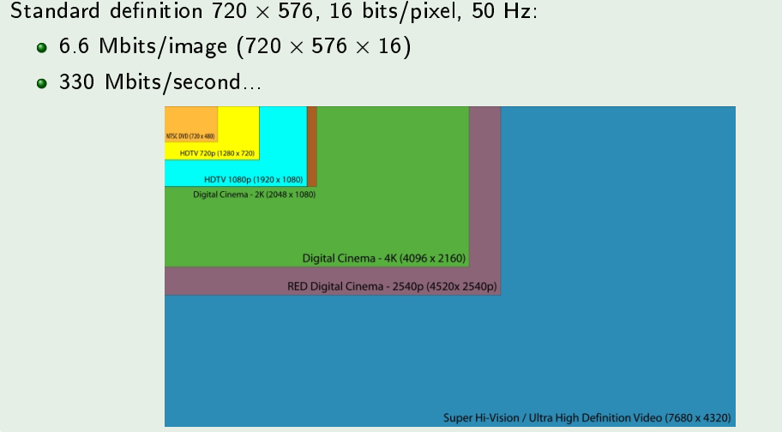
Why we need compression?
Reducing the amount of data required to represent a digital image

Slide 26
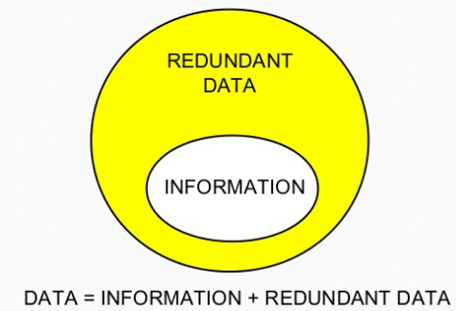
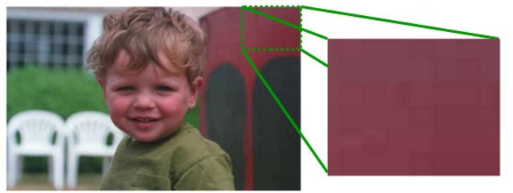
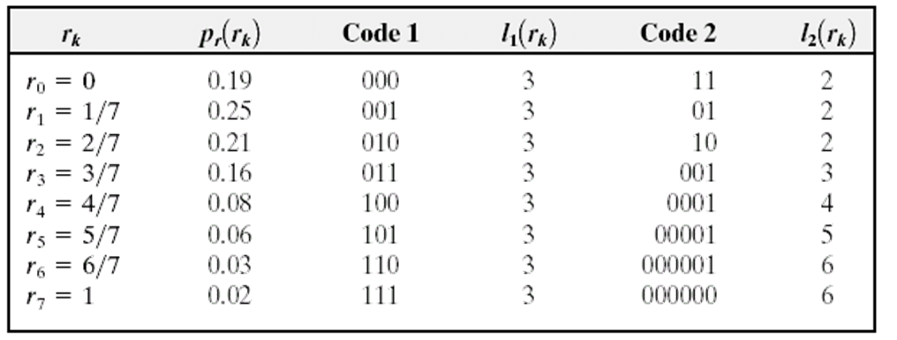
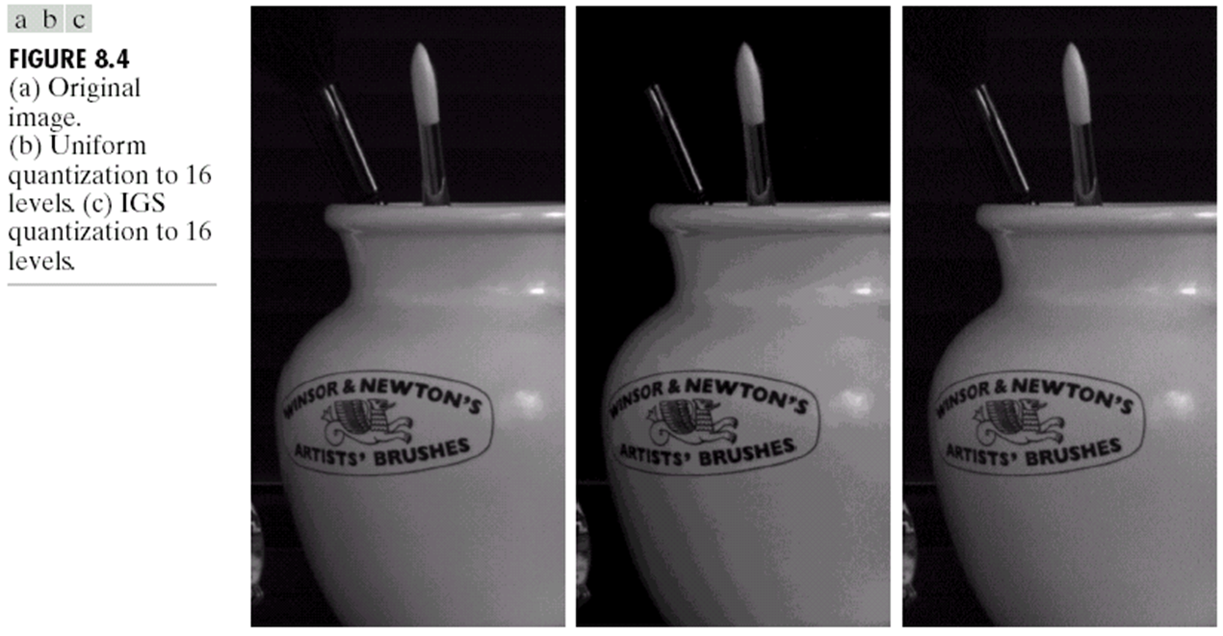
Motivation
Data = Redundant Data + Information
(R1) Spatial redundancy: similarity bet. nearby pixels
(R2) Coding Redundancy: some codes happened more frequently
(R3) Perceptual Redundancy: human is more sensitive to low-freq

Slide 27
JPEG Compression
A lossy compression technique
R3
R2
R2

Slide 28
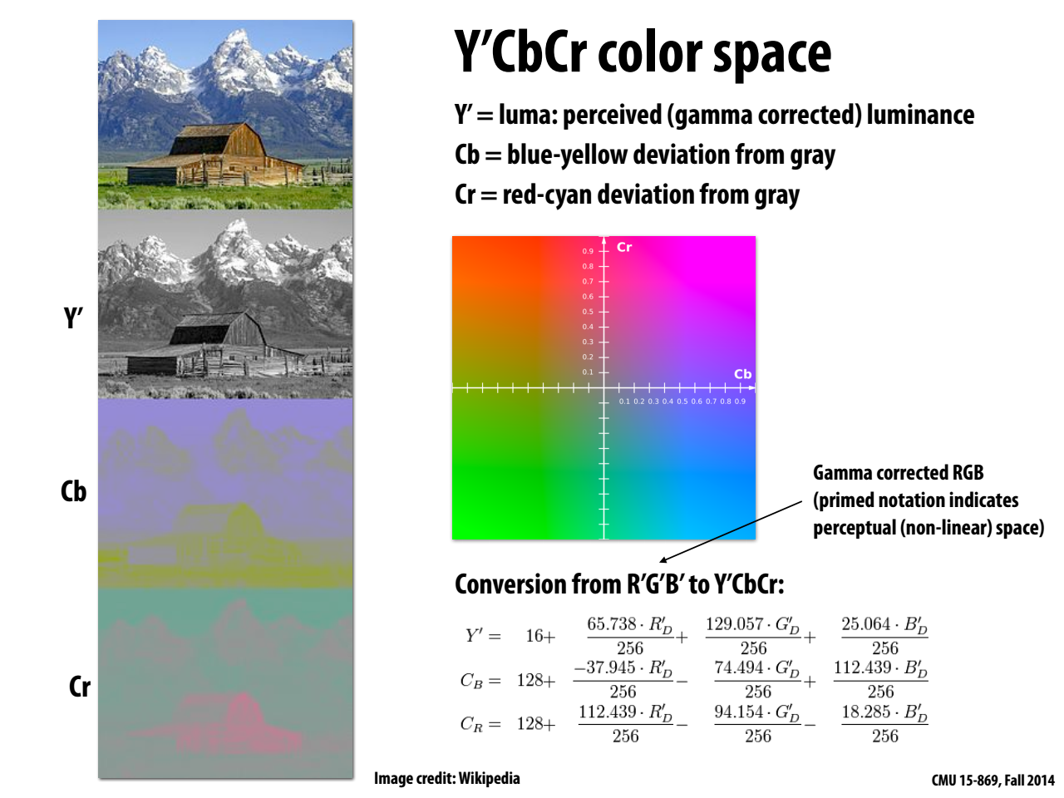
Step 1. Color Conversion (1)

Slide 29
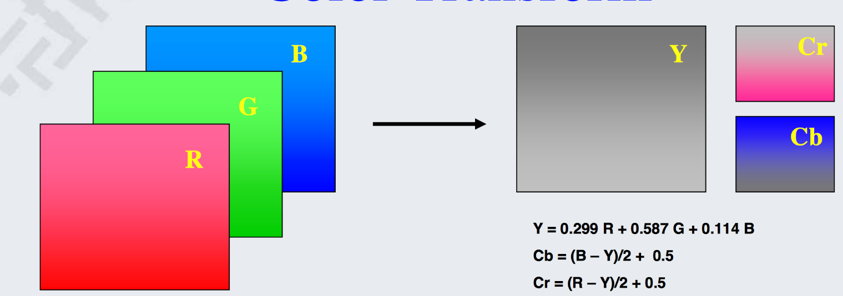
Step 1. Color Conversion (1)
Convert RGB to YCrCb image
Y is the luminance or grayscale
Cr, Cb is the chrominance or color (blue and red).
(R3) Human eyes are less sensitive to color information
Reduce (down samp.) info in Cr, Cb without losing significant visual quality

Slide 30
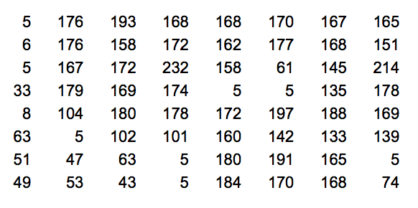
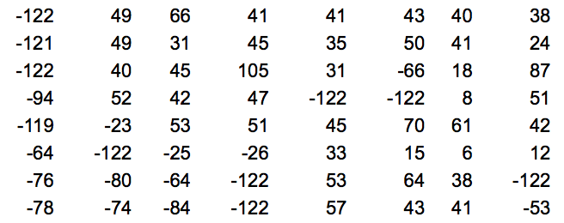
Step 2. Preprocessing for DCT
Block partitioning: non-overlapping of size 8x8
Normalize the pixels value to -128 to 127 from 0 to 255
By subtracting 128 from each pixel value.
1. Block Partitioning
2. Normalization

Slide 31
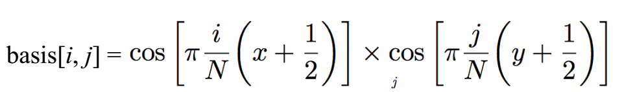
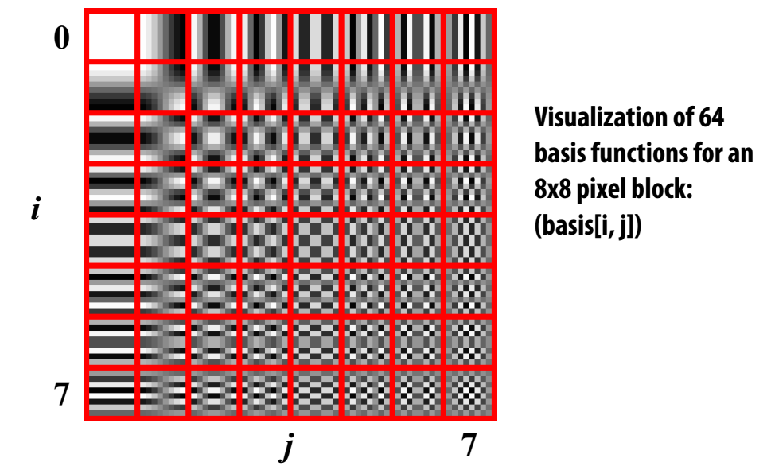
Step 3. Discrete Cosine Transform
Project each 8x8 block from pixel (spatial) basis to cosine basis

Slide 32
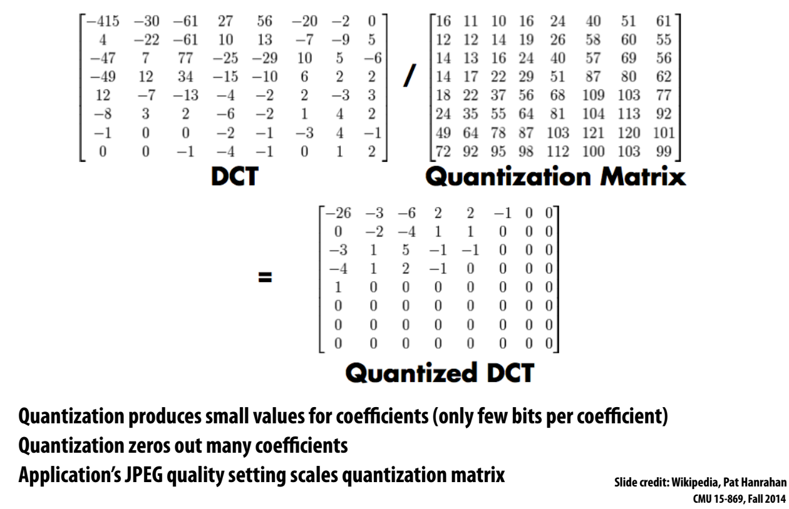
Step 5. Quantization (1)
DC
AC is other

Slide 33
Step 5. Quantization (2)
Control compression quality via quantization table

Slide 34
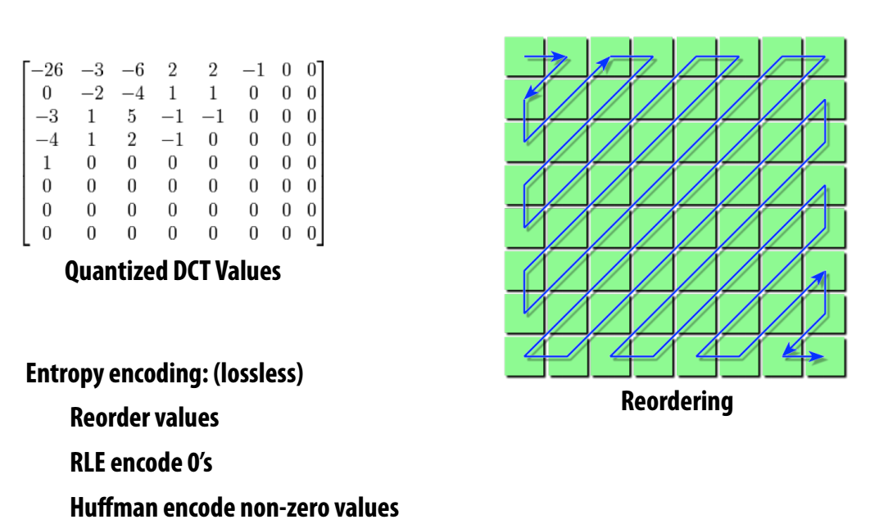
Step 6. Zig Zag Scanning
Scan data in Zig zag scan fashion

Slide 35
Step 7. Coding DC and AC (1)
Differential prediction model (DPCM)
DPCM Coding for DC
DC coefficient is fairly unpredictable by itself.
But correlation exists bet the DC of adjacent blocks.
Only encode the residual

Slide 36
Step 7. Coding DC and AC (2)
Run length coding of AC:
AC values tend towards zero
Quantized DCT blocks has many zero-value bytes
Entropy Coding Huffman or Arithmetic coding is used

Slide 37
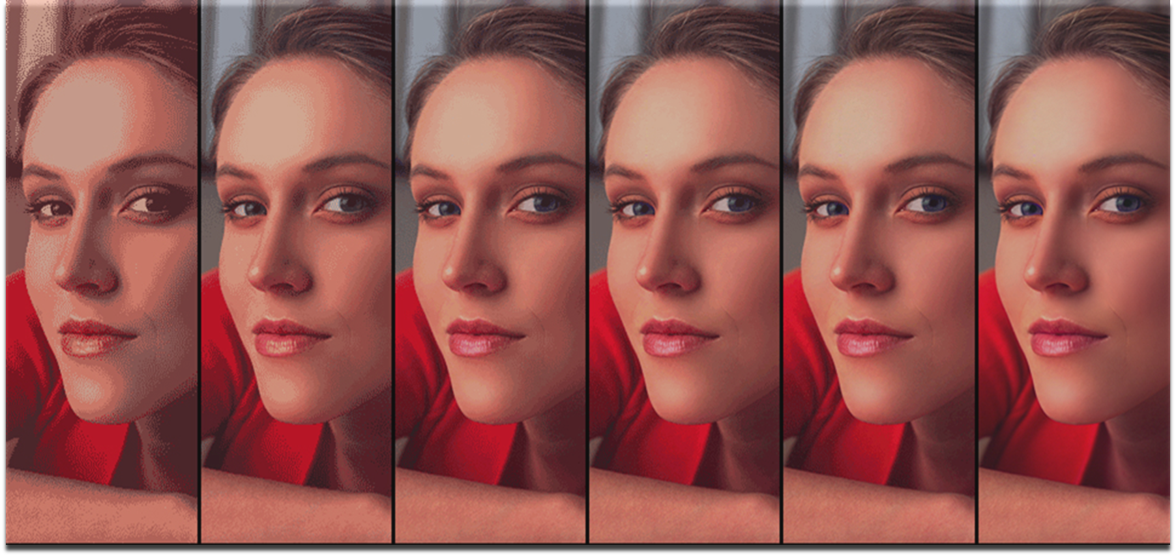
JPEG Compression Artifact

